Slide 1
Prokaryotes v. Eukaryotes

Slide 2
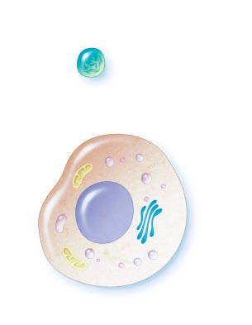
Prokaryotic v. Eukaryotic Cells
Cell size comparison
Figure 1
← Prokaryote or Eukaryote?
Figure 2
← Prokaryote or Eukaryote?

Slide 3
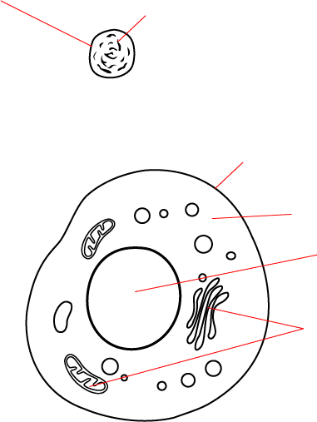
Section 7-1
Plasma membrane
Cytoplasm
Prokaryotic Cell
Plasma membrane
Cytoplasm
Nucleus
Eukaryotic Cell
Organelles
Go to Section:

Slide 4
Venn Diagram
Prokaryotes
Eukaryotes
Nucleus
Organelles
(Endoplasmic reticulum
Golgi apparatus
Lysosomes
Vacuoles
Mitochondria
Chloroplasts)
Plasma membrane
Ribosomes (some)
Cell wall (some)
Cytoplasm

Slide 5
Examples
Eukaryotes
Prokaryotes
Bacteria
Plants
Animals (humans, too)
Fungi
Some single-celled organisms (ex: amoeba, paramecium, euglena)

