Slide 1
Cell Transport

Slide 2



Active Transport v. Passive Transport
Active Transport
Passive Transport
Requires energy
No energy required

Slide 3
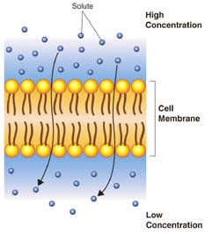
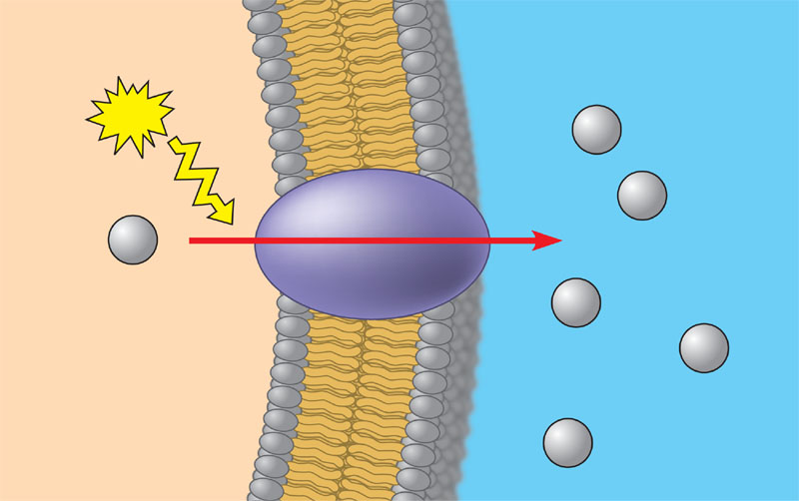
Active Transport v. Passive Transport
Active Transport
Passive Transport
From lower concentration to higher concentration (against gradient)
From higher concentration to lower concentration (with gradient)

Slide 4
Active Transport v. Passive Transport
Active Transport
Passive Transport

Slide 5
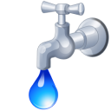
Active Transport v. Passive Transport
Active Transport
Passive Transport
Exocytosis
Endocytosis
Phagocytosis
Pinocytosis
Ion Pumps
Diffusion
Osmosis
Facilitated Diffusion

Slide 6
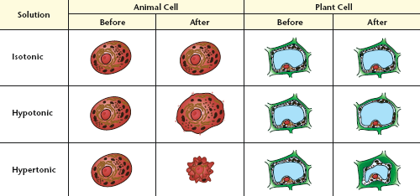
Osmosis in
Animal Cells & Plant Cells

