Slide 1
Laboratory safety
Mrs. Kirby’s Biology I, Honors Biology I, and AP Biology

Slide 2
General Safety

Slide 3

General Safety
Always follow teacher’s instructions.
Do not eat or drink anything in lab.
No horseplay.
Inform teacher of health problems.
Keep lab free of paper.
Wash hands after lab.
No destruction of others’ work.

Slide 4
Laboratory Dress Code

Slide 5

Laboratory Dress Code
Always wear shoes.
Tie back loose hair.
No loose clothing.
Wear safety goggles, when instructed.

Slide 6
First Aid

Slide 7

First Aid
Report to teacher immediately any accidents, injuries, or spills.
In case of an acid spill, rinse off with lots of water.
Learn locations of safety equipment.

Slide 8
Glassware Safety

Slide 9

Glassware Safety
Handle glassware with care and common sense.
Never use any chipped or broken glassware – let teacher know immediately.

Slide 10
Sharp Instrument Safety

Slide 11
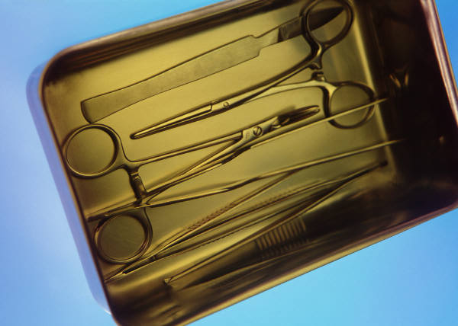
Sharp Instrument Safety
Sharp instruments include: scalpels, dissecting pins, and scissors.
Handle sharp instruments with care and common sense.
Always cut away from you.

Slide 12
Chemicals Usage Safety

Slide 13

Chemical Usage Safety
Close lids tightly when chemicals are not in use.
Never pour back any chemical into its original container, to avoid contamination.
Acids and bases require special care: Never pour water into acid.
If you are to note the fumes of a chemical, wave your hand over the chemical to direct the fumes toward you – never inhale fumes directly.

Slide 14
Heating and Fire Safety

Slide 15

Heating and Fire Safety
Never leave flame unattended.
Never heat liquids in closed containers to avoid explosion.
Use tongs or heat-resistant gloves to handle hot containers or burners.

Slide 16
Lab Animal Safety

Slide 17
Lab Animal Safety
All living and preserved animals require to be treated with care and respect.
Treat all microorganisms as if they were harmful, dispose of them appropriately, and disinfect all work areas.

